Slide 1
Chapter 3

Slide 2
Objectives

Slide 3
Objectives (cont.)

Slide 4
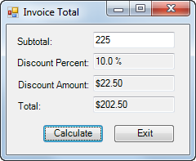
A form object and its ten control objects

Slide 5
Class and object concepts

Slide 6
Property, method, and event concepts

Slide 7
Objects and forms

Slide 8
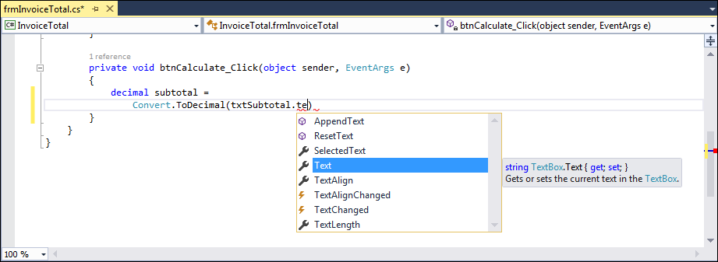
A member list in the Code Editor window

Slide 9
The syntax for referring to a member of a class or object

Slide 10
Statements that refer to methods

Slide 11
How to enter member names when working in the Code Editor

Slide 12
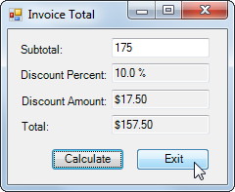
Event: The user clicks the Exit button

Slide 13
Common control events

Slide 14
How an application responds to events

Slide 15
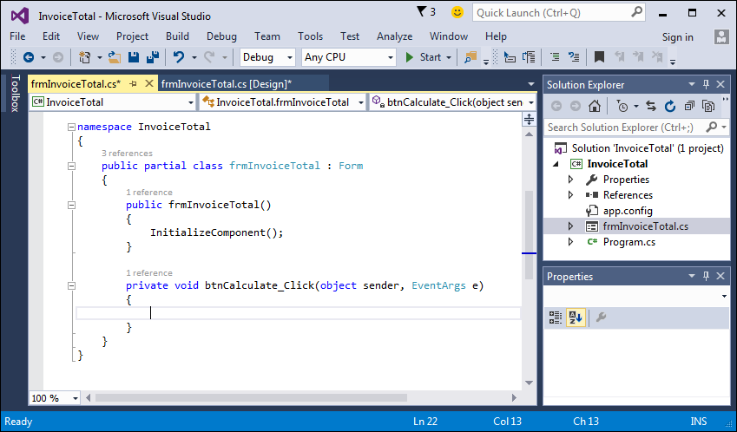
The method that handles the Click event of the Calculate button
Object
Event

Slide 16
How to handle the Click event of a button

Slide 17
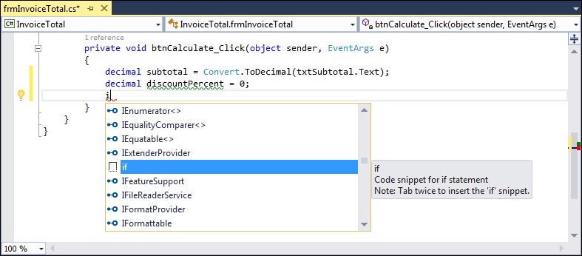
The completion list that’s displayed when you enter a letter at the beginning of a line of code

Slide 18
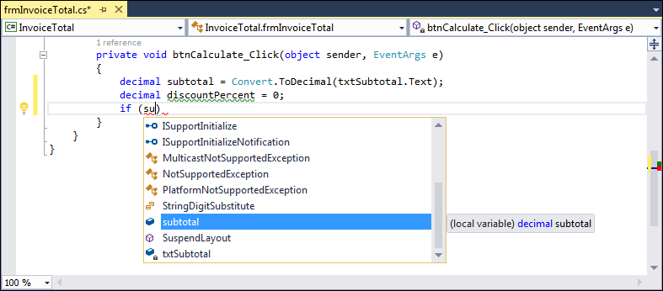
The completion list that’s displayed as you enter code within a statement

Slide 19
The event handlers for the Invoice Total form

Slide 20
The event handlers for the Invoice Total form (cont.)

Slide 21
Coding rules

Slide 22
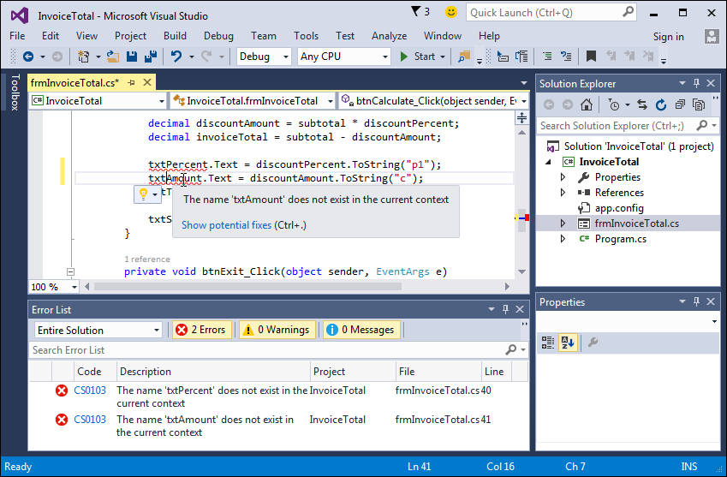
The Code Editor and Error List windows with syntax errors displayed

Slide 23
A method written in a readable style

Slide 24
A method written in a readable style (cont.)

Slide 25
A method written in a less readable style

Slide 26
Coding recommendations

Slide 27
A method with comments

Slide 28
A method with comments (cont.)

Slide 29
How to code comments

Slide 30
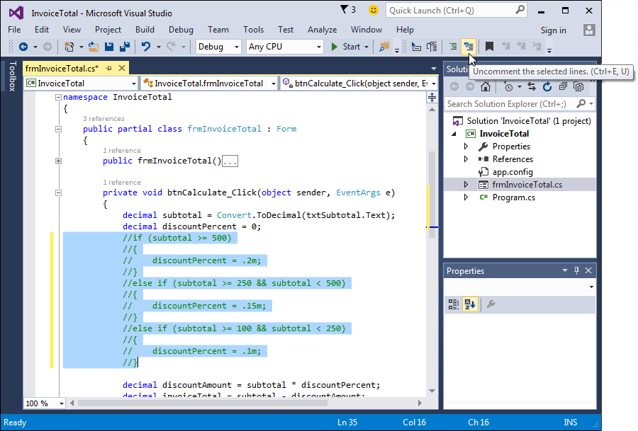
The Code Editor and the Text Editor toolbar

Slide 31
How to use the buttons of the Text Editor toolbar

Slide 32
How to collapse or expand regions of code

Slide 33
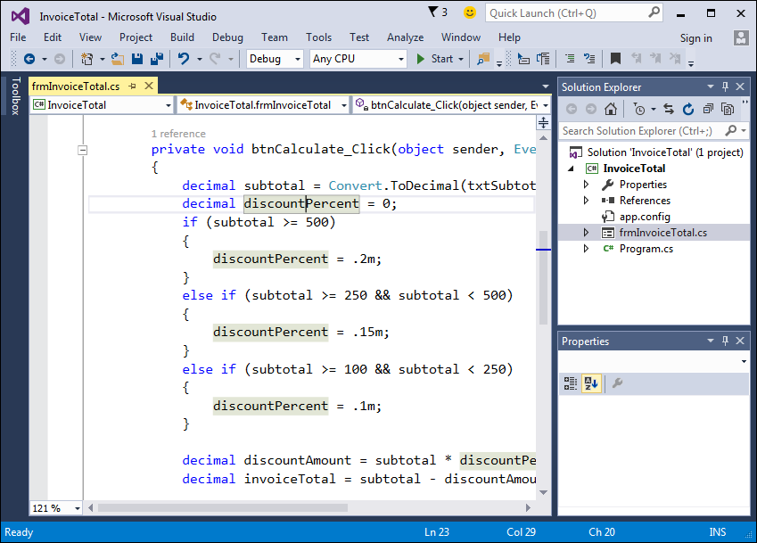
The Code Editor with enlarged text and a highlighted variable

Slide 34
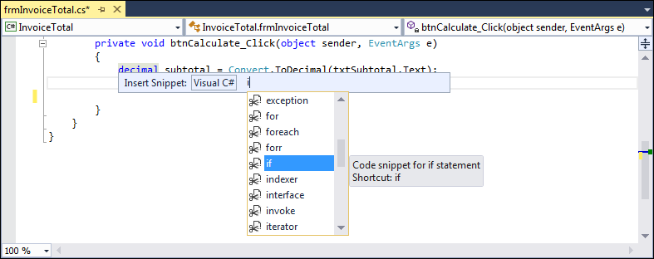
The default list of Visual C# code snippets

Slide 35
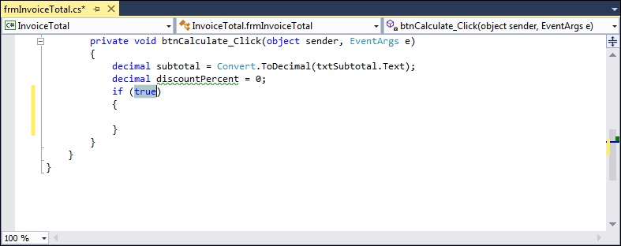
A code snippet after it has been inserted

Slide 36
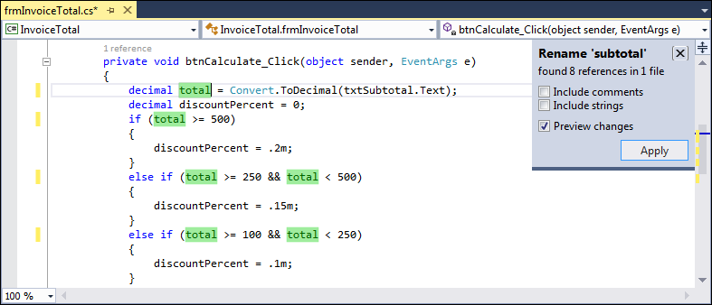
The options that are displayed when you rename a variable

Slide 37
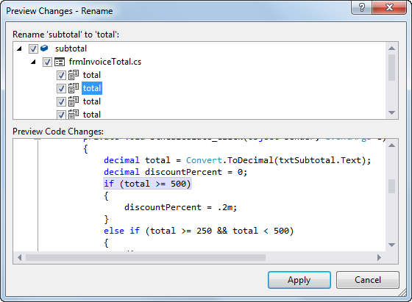
The Preview Changes - Rename dialog box

Slide 38
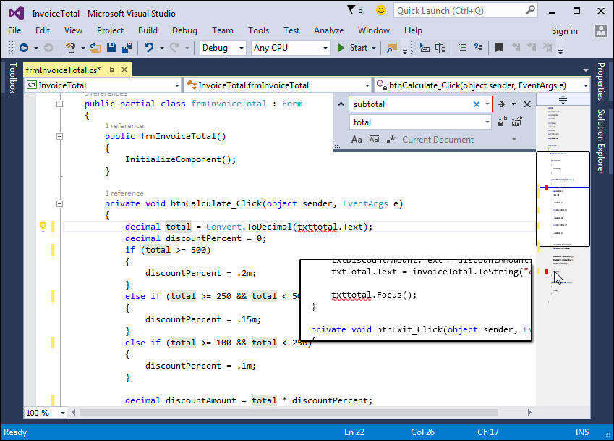
A scroll bar in map mode with annotations

Slide 39
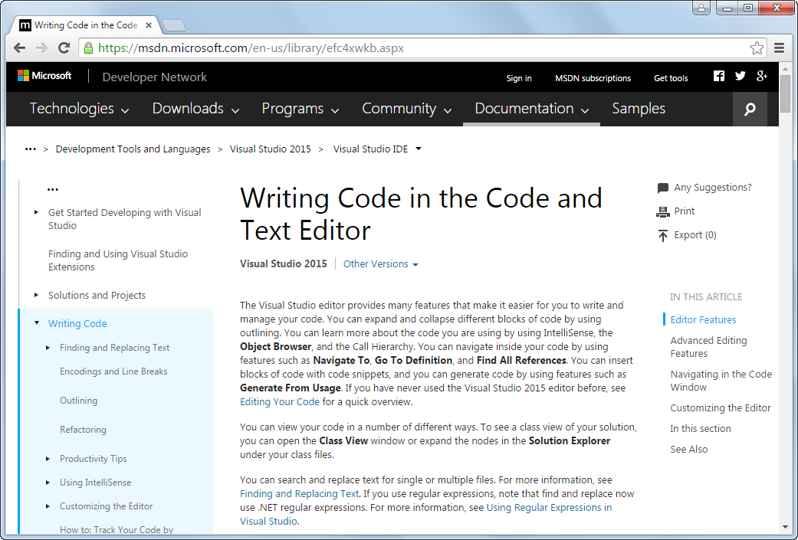
Online help for Visual Studio

Slide 40
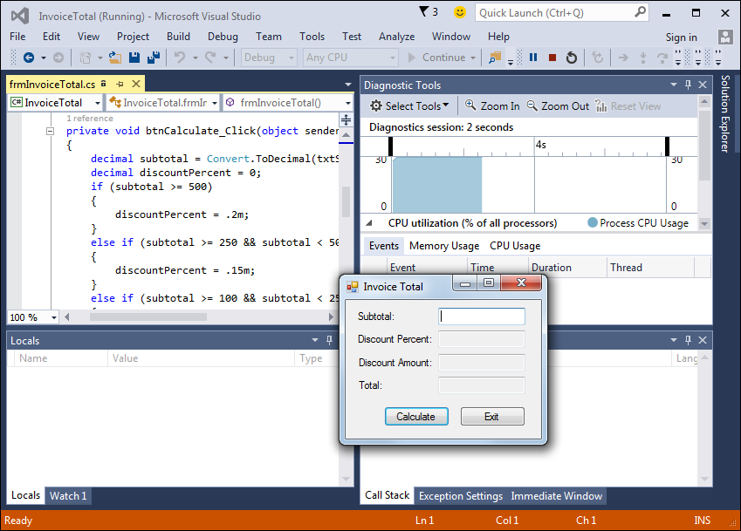
The form that’s displayed when you run the Invoice Total project

Slide 41
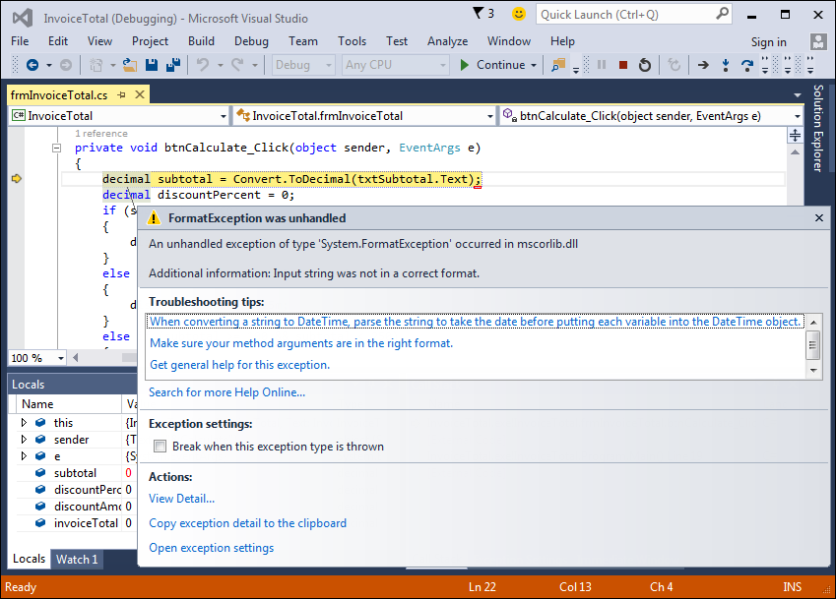
The Exception Assistant that’s displayed when a runtime error occurs

Slide 42
How to test a project

Slide 43
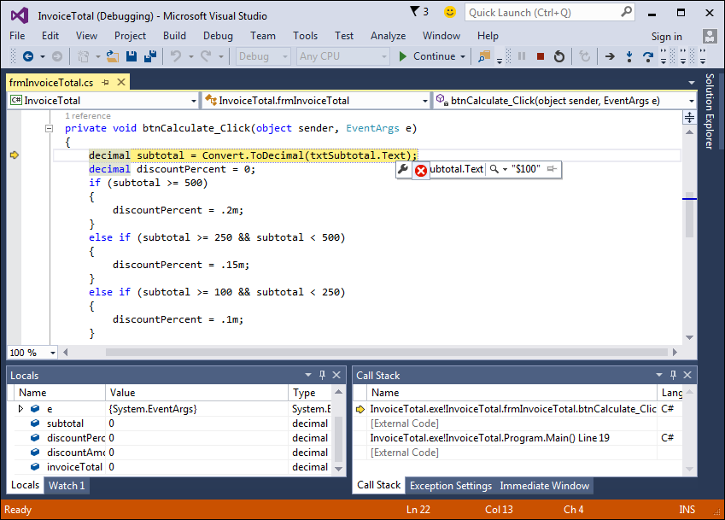
How a project looks in break mode

